Slide 1

Modern Microservices
An Introduction
Daniel Williams (dwilliams@kenzan.com)
2018-06-21
https://github.com/kenzanlabs/modernmicroservices

Slide 2
About
Kenzan
We are a software engineering and digital consulting firm that has been helping clients Make Next Possible for over a decade:
Core offerings Application Development, Platform as a service, cloud virtualization, platform engineering, consulting services and business transformation.
Primary Clients Multi billion dollar companies and media/content providers such as Thompson Reuters, Charter & Cablevision Locations Providence (RI), New York (NY), Denver (CO), Los Angeles (CA), and a London presence
Founded in 2004.
Full Service Consulting Firm Architecture, front and back end development, business analysis and DevTest.
Cloud Virtualization Experts And Enablers AWS, Netflix stack, enterprise architecture and beyond.
DevOps Leadership Platform builds, continuous delivery and scalable resourcing.
Veterans of the Media Industry Migrations, enterprise wide solutions, digital experts and thought leaders.
Employee focused Collaboration, communication and culture are key.

Slide 3


Agenda
Multiple Part Series Focusing on:
Platform & Infrastructure
Continuous Delivery
Continuous Integration
Application
Notes:
Talk a bit about:
We’re starting basic, but not “Cloud 101”
We’ll get more advanced in future sessions
Today, we’re keeping it high level
Ask questions throughout the session, don’t wait until the end

Slide 4
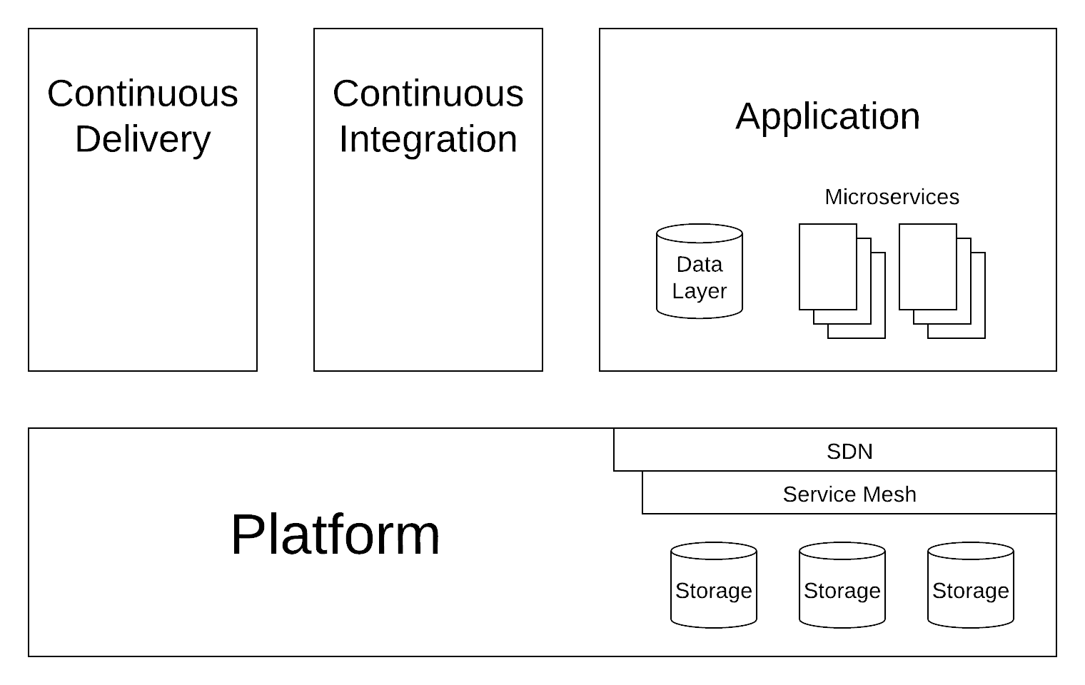
The Whole Picture

Slide 5
Platform & Infrastructure
Gotta have Application Programming Interfaces (APIs)
No, Secure Shell (SSH) is not an API
Gotta be automatable

Slide 6
Platform & Infrastructure
Software Defined Networking (SDN) is a must have.
Virtual networking
Allows reconfiguration of the network via API control
e.g. AWS or GCP Virtual Private Cloud (VPC)
Service Meshes are good.
Advanced proxying system
Usually handles load balancing, application request routing, circuit breaking
e.g. Istio

Slide 7
Platform & Infrastructure
Gotta have Storage
Usually block storage
e.g. AWS Elastic Block Store (EBS)
Examples:
Kubernetes (EKS, GKE, KOPS)
Amazon EC2
Google Cloud Compute
OpenStack
Ubuntu's MAAS

Slide 8
Continuous Delivery
Gotta have APIs
Gotta be automatable
Pipelines help organize processes
Gotta have triggers
e.g. Upon successful build, deploy to the test environment
Notes:
Delivery vs Deployment
Delivery is the process
Deployment is what pops out

Slide 9
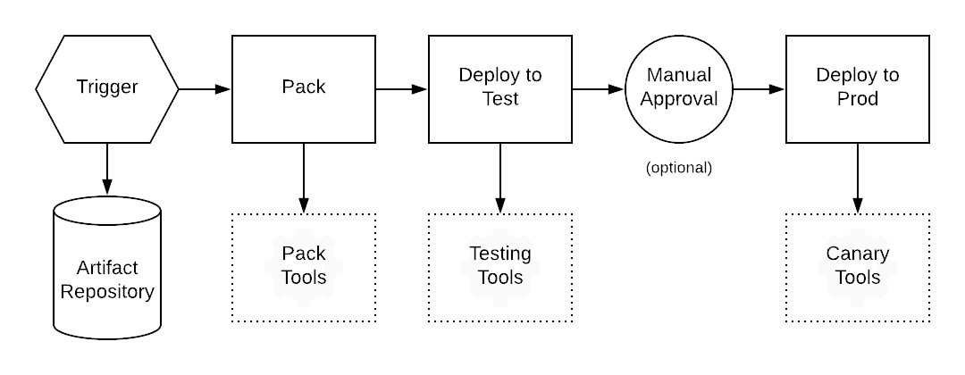
Continuous Delivery
Notes:
Delivery vs Deployment
Delivery is the process
Deployment is what pops out

Slide 10
Continuous Delivery
Gotta have Service Discovery
Allows a microservice to find other needed microservices
e.g. Eureka
Gotta have Health Checks
Verifies the microservice is running and happy
Can be built into the microservice, handled by a sidecar, or handled by an external service

Slide 11
Continuous Delivery
Integration & Canary testing happens here
Examples:
Spinnaker
Titus
AWS CodeDeploy, CodePipeline, CloudFormation
Eureka, Consul, etcd, AWS LBs
Terraform
Ansible
Chef & Puppet
Notes:
What is Canary Testing?

Slide 12
Continuous Integration
Gotta have APIs (Seeing a theme yet?)
Gotta be automatable
Gotta have triggers
e.g. Upon commit to source repo, build project

Slide 13
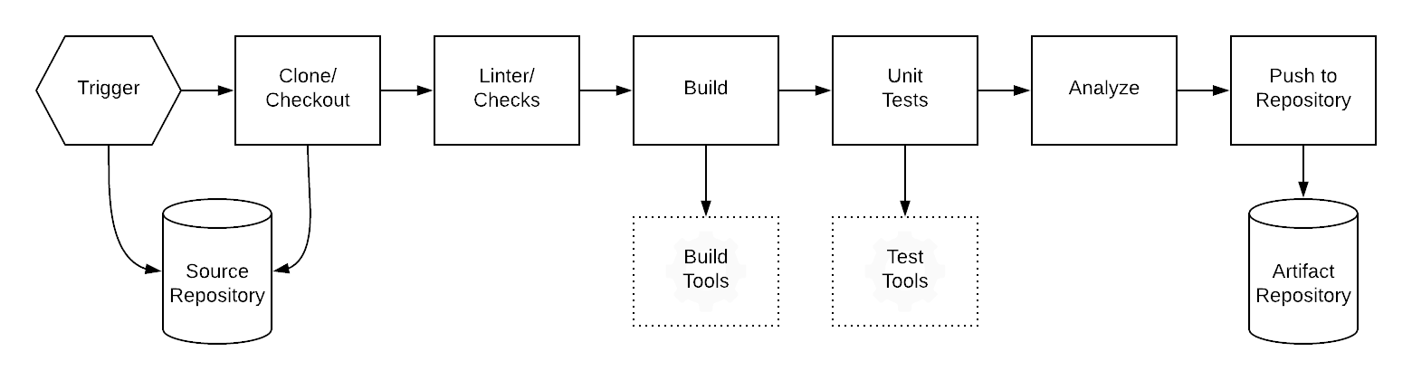
Continuous Integration

Slide 14
Continuous Integration
Gotta have source storage / repositories.
Artifact storage is a very nice to have
Stores and versions already built things
Required for larger systems

Slide 15
Continuous Integration
Unit and Component (fixtured) testing happens here
Examples:
Github, GitLab, Git
Jenkins, TravisCI, GitLabCI, CircleCI
AWS & GCP Built Ins
Docker Repos
Code Analysis (e.g. Linter)

Slide 16
Application (Data Layer)
Databases
Don't get cycled often
Often ignored, but this is where the money (data) is.

Slide 17
Application (Data Layer)
Disaster Recovery testing happens here
Examples:
NoSQL (e.g. Redis, MongoDB, CouchDB)
SQL / Relational (e.g. Postgres, MySQL, Maria, MSSQL, The 7+ Digit DBs)
Queues
Enterprise Service Buses (ESBs)

Slide 18
Application (Microservices)
Gotta have APIs
Logic happens here
Usually try to be event driven
Better efficiency
Required for scalability

Slide 19
Application (Microservices)
The Single Responsibility Paradigm
aka The Unix Paradigm
Do only one thing, but do it very well
12 Factor App: https://12factor.net/
Use well defined interfaces
(Programming) Language shouldn't matter
A good interface is worth its weight in gold
Notes:
Example from Spinnaker:
https://www.spinnaker.io/reference/architecture/

Slide 20
Application (Microservices)
Service Discovery
Sidecars
Add in to a microservice to provide support
e.g. health checks, service discovery client
Configuration from the Environment
No configuration in artifacts
Circuit Breaker Pattern

Slide 21
Application (Microservices)
Examples:
Swagger (OpenAPI Spec)
Python, Flask
NodeJS, Loopback
Go
Hystrix

Slide 22
Capstan Walkthrough
https://github.com/kenzanlabs/capstan
Work In Progress
Reference implementation of a turn-key microservices ecosystem

Slide 23
Upcoming Talks in Series
Platforms & Infrastructure (July 19th, 2018)
Kubernetes, Istio (Istio presentation by Aspen Mesh)
Application Development (To Be Announced)
Loopback, Languages, Patterns
Continuous Integration (To Be Announced)
Build Systems, Tooling, Build Pipelines
Continuous Deployment (To Be Announced)
Spinnaker, Eureka

Slide 24




Want to learn more?
Follow us!
@kenzanmedia
www.linkedin.com/company/kenzan-media
techblog.kenzan.com
www.facebook.com/kenzanmedia/

